Slide 1
Dynamic Load Balancing in Charm++
Invoking Load Balancers, and serialization via PUPs
© 2018 L. V. Kale at the University of Illinois Urbana

Slide 2
Dynamic Load Balancing
Object-based decomposition (i.e., virtualized decomposition) helps
Charm++ RTS reassigns objects to PEs to balance load
But how does the RTS decide?
Multiple strategy options
E.g., just move objects away from overloaded processors to underloaded processors
How is load determined?

Slide 3
Measurement Based Load Balancing
Principle of persistence
Object communication patterns and computational loads tend to persist over time
In spite of dynamic behavior
Abrupt but infrequent changes
Slow and small changes
Recent past is a good predictor of near future
Runtime instrumentation
Measures communication volume and computation time
Measurement-based load balancers
Measure load information for chares
Periodically use the instrumented database to make new decisions and migrate objects
Many alternative strategies can use the database
Notes:
User can specify load info instead

Slide 4
Using the Load Balancer
Link a LB module
-module <strategy>
RefineLB, NeighborLB, GreedyCommLB, others
EveryLB will include all load balancing strategies
Compile time option (specify default balancer)
-balancer RefineLB
Runtime option (override default)
+balancer RefineLB

Slide 5
Instrumentation
By default, instrumentation is enabled
Automatically collects load information
Sometimes, you want LB decisions to be based only on a portion of your program
To disable by default, provide runtime argument +LBOff
To toggle instrumentation in code, use LBTurnInstrumentOn() and LBTurnInstrumentOff()

Slide 6
Code to Use Load Balancing
Set usesAtSync = true; in chare constructor
Insert AtSync() call at a natural barrier
Call from every chare in all collections
Does not block
Implement ResumeFromSync() to resume execution
A typical ResumeFromSync() contributes to a reduction
Notes:
PUP later

Slide 7
Example: Stencil
// Synchronize at every iteration: Main starts next iteration
void Main::endIter(err) { if (err < T) CkExit();
else stencilProxy.sendBoundaries(); }
// Assume a 1D Stencil chare array with near neighbor communication
void Stencil::sendBoundaries() { thisProxy(wrap(x-1)).updateGhost(RIGHT, left_ghost);
thisProxy(wrap(x+1)).updateGhost(LEFT, right_ghost);
}
void Stencil::updateGhost(int dir, double ghost) { updateBoundary(dir, ghost);
if (++remoteCount == 2) {
remoteCount = 0;
doWork(); } }

Slide 8
Example: Stencil (cont.)
void Stencil::doWork() { e = (computeKernel() < DELTA);
if (++i % 10 == 0) { AtSync(); } // Allow load balancing every 10 iterations
else contribute(8, e, CkCallback(CkReductionTarget(Main, endIter), mainProxy)); }
}
void Stencil::ResumeFromSync() {
contribute(CkCallback(CkReductionTarget(Main, endIter), mainProxy));
}

Slide 9
Serialization and PUP
How can the RTS move arbitrary objects across nodes?
Charm++ has a framework for serializing data called PUP
PUP: Pack and Unpack
With PUP, chares become serializable and can be transported to memory, disk, or another processor

Slide 10
Simple PUP for a Simple Chare
class MyChare :
public Cbase_MyChare {
int a;
float b;
char c;
double localArray[LOCAL_SIZE];
};
void pup(PUP::er &p) {
p | a;
p | b;
p | c;
p(localArray, LOCAL_SIZE);
}

Slide 11
Writing an Advanced PUP Routine
class MyChare : public Cbase_MyChare {
int heapArraySize;
float* heapArray;
MyClass* pointer;
};
void pup(PUP::er &p) {
p | heapArraySize;
if (p.isUnpacking()) {
heapArray = new float[heapArraySize]; }
p(heapArray, heapArraySize);
bool isNull = !pointer;
p | isNull;
if (!isNull) {
if (p.isUnpacking()) {
pointer = new MyClass(); }
p | *pointer; }}

Slide 12
PUP Uses
Moving objects for load balancing
Marshalling user defined data types
When using a type you define as a parameter for an entry method
Type has to be serialized to go over network, uses PUP for this
Can add PUP to any class, doesn’t have to be a chare
Serializing for storage

Slide 13
Split Execution: Checkpoint Restart
Can use to stop execution and resume later
The job runs for 5 hours, then will continue in new allocation another day!
We can use PUP for this!
Instead of migrating to another PE, just “migrate” to disk
Bonus: in a well-written program, you can resume on a different number of nodes
Example: Original run on 100 nodes, checkpointed, can be resumed on 80 nodes (say because that’s what was available).

Slide 14
How to Enable Split Execution
Call to checkpoint the application is made in the main chare at a synchronization point
log_path is file system path for checkpoint
Callback cb called when checkpoint (or restart) is done
For restart, user needs to provide argument +restart and path of checkpoint file at runtime
CkCallback cb (CkIndex_Hello:SayHi(), helloProxy);
CkStartCheckpoint(“log_path”, cb);
shell> ./charmrun hello +p4 +restart log_path
Notes:
P can be different number

Slide 15
Control Flow within Chare
Structured dagger notation
Provides a script-like language for expressing dag of dependencies between method invocations and computations
Threaded entry methods
Allows entry methods to block without blocking the PE
Supports futures and
Ability to suspend/resume threads

Slide 16
Advanced Concepts
Priorities
Entry method tags
Quiescence detection
LiveViz: visualization from a parallel program
CharmDebug: a powerful debugging tool
Projections: Performance Analysis and Visualization, really nice, and a workhorse tool for Charm++ developers
Messages (instead of marshalled parameters)
Processor-aware constructs:
Groups: like a non-migratable chare array with one element on each “core”
Nodegroups: one element on each process

Slide 17
Saving Cooling Energy
Easy: increase A/C setting
But: some cores may get too hot
So, reduce frequency if temperature is high (DVFS)
Independently for each chip
But, this creates a load imbalance!
No problem, we can handle that:
Migrate objects away from the slowed-down processors
Balance load using an existing strategy
Strategies take speed of processors into account
Implemented in experimental version
SC 2011 paper, IEEE TC paper
Several new power/energy-related strategies
PASA ‘12: exploiting differential sensitivities of code segments to frequency change

Slide 18
PARM: Power Aware Resource Manager
Charm++ RTS facilitates malleable jobs
PARM can improve throughput under a fixed power budget using:
Overprovisioning (adding more nodes than conventional data center)
RAPL (capping power consumption of nodes)
Job malleability and moldability

Slide 19
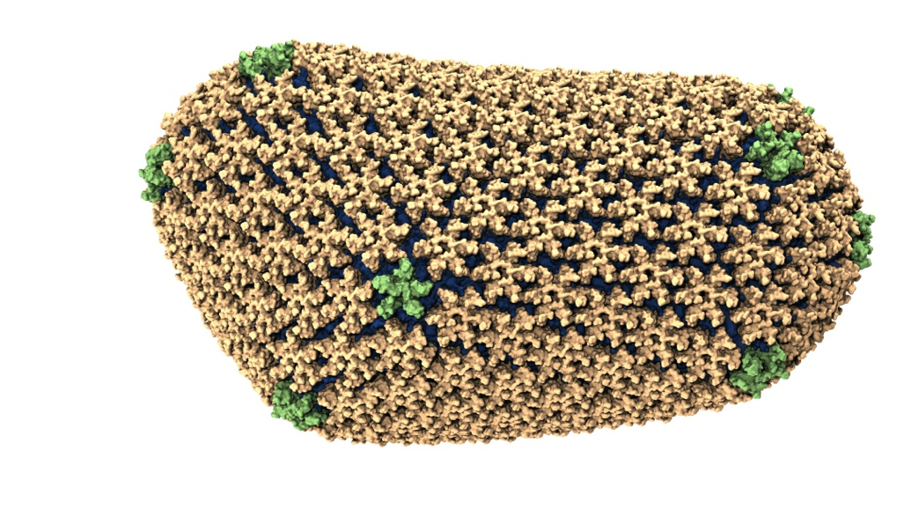
NAMD: Biomolecular Simulations
Collaboration with K. Schulten
With over 70,000 registered users
Scaled to most top US supercomputers
In production use on supercomputers and clusters and desktops
Gordon Bell award in 2002
Determination of the structure of HIV capsid by researchers including Prof Schulten

Slide 20
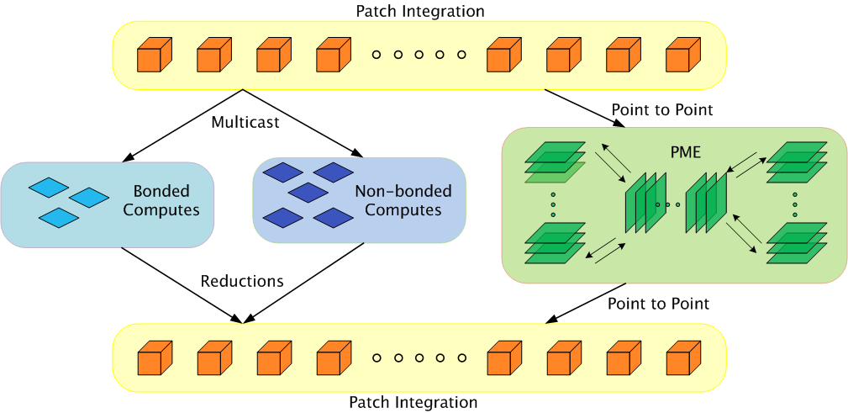
Parallelization Using Charm++

Slide 21
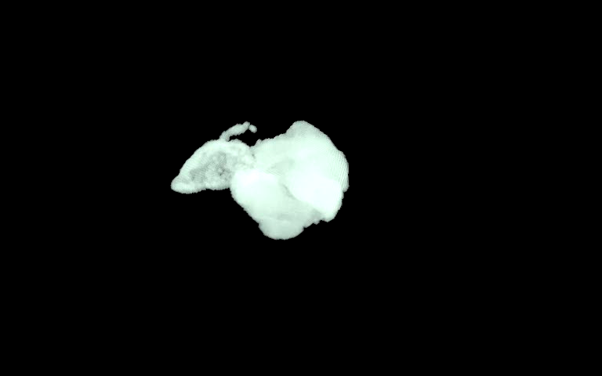
ChaNGa: Parallel Gravity
Evolution of Universe and Galaxy Formation
Collaborative project (NSF)
With Tom Quinn, Univ. of Washington
Gravity, gas dynamics
Barnes-Hut tree codes
Oct tree is natural decomp
Geometry has better aspect ratios, so you “open” up fewer nodes
But is not used because it leads to bad load balance
Assumption: one-to-one map between sub-trees and PEs
Binary trees are considered better load balanced
With Charm++: use Oct-Tree, and let Charm++ map subtrees to processors

Slide 22
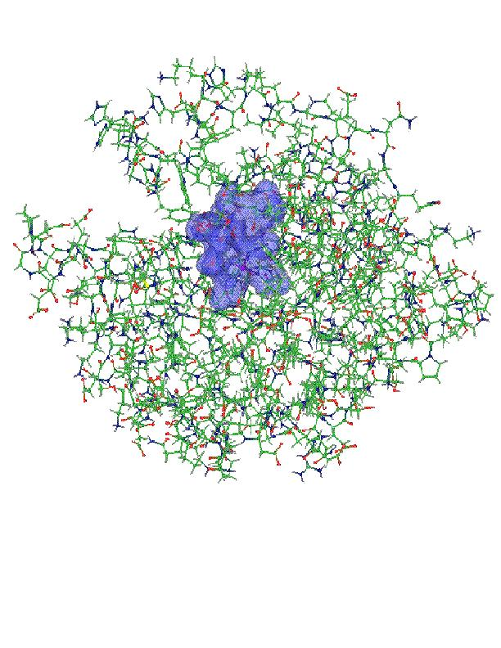
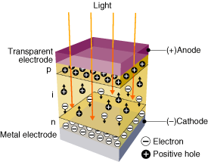
OpenAtom:
On the fly ab initio molecular dynamics on the ground state surface with instantaneous GW-BSE level spectra
PIs: G.J. Martyna, IBM; S. Ismail-Beigi, Yale; L. Kale, UIUC;
Team: Q. Li, IBM, M. Kim, Yale; S. Mandal, Yale;
E. Bohm, UIUC; N. Jain, UIUC; M. Robson, UIUC; E. Mikida, UIUC; P. Jindal, UIUC; T. Wicky, UIUC.
Light in
1

Slide 23
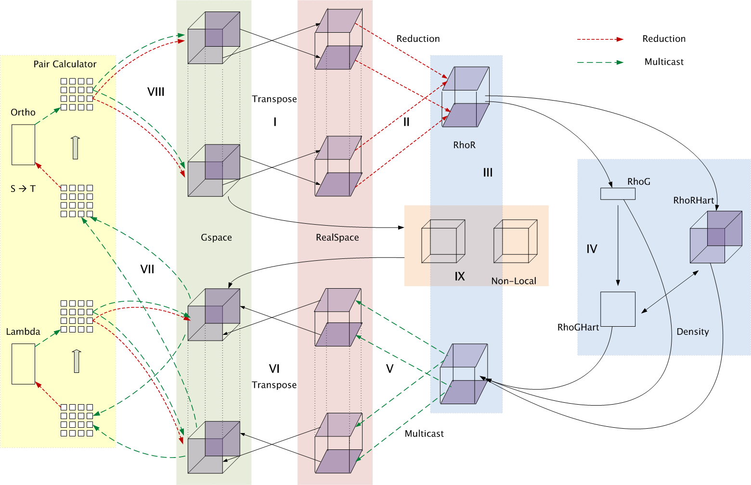
Decomposition and Computation Flow

Slide 24
MiniApps
Available at: http://charmplusplus.org/miniApps/
MiniApp | Features | Machine | Max cores
AMR | Over-decomposition, Custom array index, Message priorities, Load balancing, Checkpoint restart | BG/Q | 131,072
LeanMD | Over-decomposition, Load balancing, Checkpoint restart, Power awareness | BG/P BG/Q | 131,072 32,768
Barnes-Hut (n-body) | Over-decomposition, Message priorities, Load balancing | Blue Waters | 16,384
LULESH 2.02 | AMPI, Over-decomposition, Load balancing | Hopper | 8,000
PDES | Over-decomposition, Message priorities, TRAM | Stampede | 4,096

Slide 25
More MiniApps
MiniApp | Features | Machine | Max cores
1D FFT | Interoperable with MPI | BG/P BG/Q | 65,536 16,384
Random Access | TRAM | BG/P BG/Q | 131,072 16,384
Dense LU | SDAG | XT5 | 8,192
Sparse Triangular Solver | SDAG | BG/P | 512
GTC | SDAG | BG/Q | 1,024
SPH |  | Blue Waters | -

Slide 26
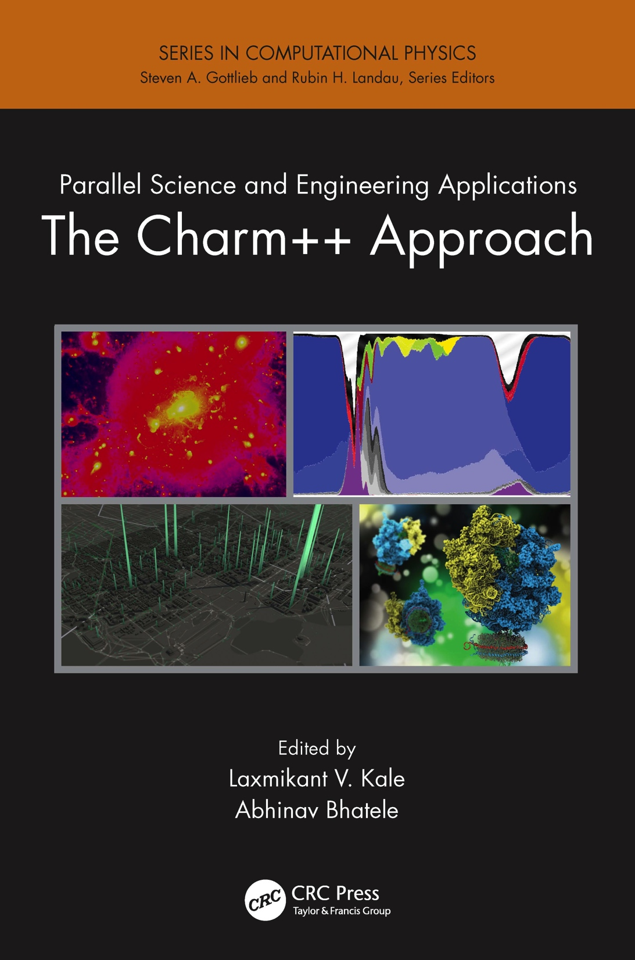
Describes seven major applications developed using Charm++
More info on Charm++:
http://charm.cs.illinois.edu
including the MiniApps

Slide 27
More information
A lecture series with instructional material coming soon
http://charmplusplus.org/ (under “Learn”)
See also “Exercises” at the same link
MiniApps (source code):
http://charmplusplus.org/miniApps/
Research projects, papers, etc.
http://charm.cs.illinois.edu/
Commercial support:
https://www.hpccharm.com/

